Slide 1

Engendering Regression:
Gender Pay Inequity in
Faculty Salaries
Nora Devlin
AERA, Toronto—April 8, 2019
Notes:
Hello and welcome.

Slide 2
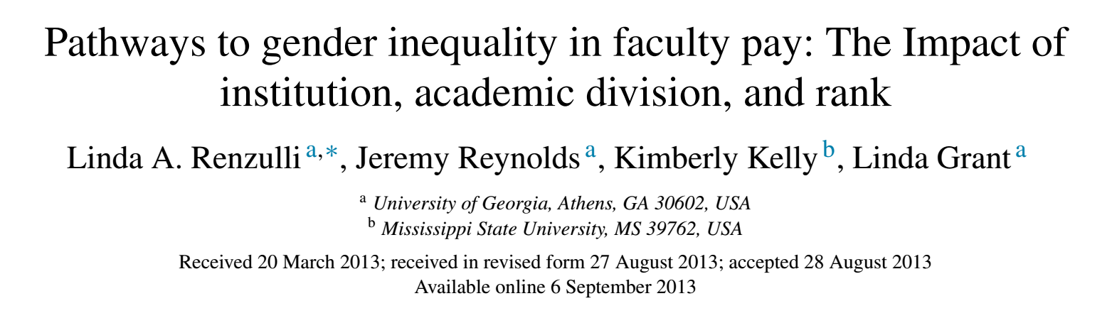
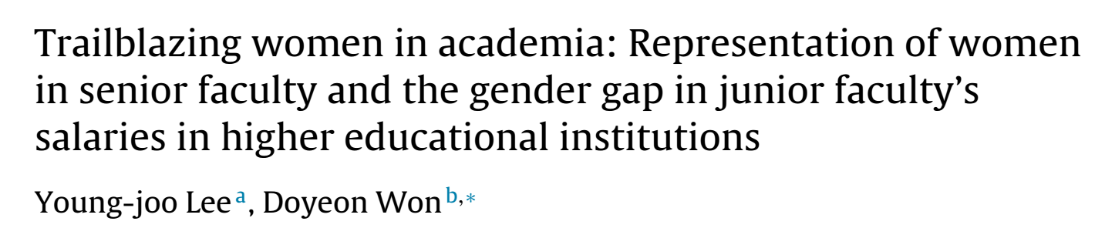
Recent Salary Studies
Move Away from Just Gender
Introduced “Gendered Niches” to show segregation
  Interaction of division, institution type, and rank
National Data from 2003-2004, published 2013
Looked at female representation
  Rank %
  University President
  State Government %
National data from 2010, published 2014
Notes:
In higher education there have been a few studies looking at national data. A couple of recent studies started moving away from looking just at gender, and considered other mediating and confounding concepts that might help us understand why women earn less than men.
The first study is by Renzulli et al, and it [click] introduced “gendered niches” to show how female faculty are more likely to be funneled into positions in particular divisions (like nursing), institutions (4-year Liberal Arts), and ranks (non-tenure-track and pre-tenure). They used national data that was already 10 years old by the time they published.
[click] Lee and Won’s study published the next year looked [click] at Female Representation in a variety of areas. They found institutions having a female president were associated with male faculty making substantially more than female faculty. Their data were a little newer, but it’s now pretty out of date. Overall, these studies have a few common weaknesses despite their helpful contributions. [click]
NOTE: Dr. Miller recommended I make this into two slides.

Slide 3
Why do another study?
Other Salary Studies:
  Use old data
  No departments
  All institution types
  Do not include Non-Tenure-Track Faculty (NTT)
  Do not account for unions
  My Study:
    Uses recent data
    Departmental data
    1 institution
    Includes NTT faculty
    Same union for all faculty
Notes:
Other studies like the ones I discussed are generally relying on older national datasets spanning many types of institutions, with no department specifications, no NTTs, and they do not account for unions. My data are especially useful because they are only 1 year old, they specify departments for every case, they are for 1 institution, including NTTs, and the same union represented all full-time faculty in 2016 including non-tenure track faculty.

Slide 4
Inclusion Criteria
Cross-sectional (2016) Institutional Data
  Full-time
  Did not include Medical School faculty
Analytic Sample of 2,017 (66% of Population)
  Male and Female only (4 missing gender)
  Departments of size 8+
  Only Ranks NTT-Distinguished Professor
  10-Month Salary only
  Removed Non-Instructional faculty (e.g., Librarians)
Notes:
This study used a cross-sectional dataset of 2016 full-time faculty salaries at one institution, which was compiled by the NSU Office of Institutional Research from institutional databases.
I filtered down to an analytic sample of 2017, or 66% of the original population of 3063 faculty. Of the 3063, four were missing gender, so they were removed. Mean salaries varied wildly among cases that had these four characteristics here (gesture) so they were not included in the sample.
In the final analytic sample, forty percent of the faculty were female.
So what am I trying to do with this study?

Slide 5
What Explains Lower Salaries for Female Faculty?
H_{A}=Female Faculty earn less than Male Faculty at Northeastern State University
  2,017 Full-time Faculty
  2016 Base Salary in Dollars
Accounting for
Rank
Discipline
Demographic Characteristics
  Age
  Racial/Ethnic Minority
Departmental Characteristics
  Size
  Percent female
Notes:
My study asks if female faculty’s 2016 salaries were less than male faculty’s salaries at Northeastern State University in an analytic sample of 2,017 full-time faculty outside the medical school.
To answer this question I needed to account for Discipline and Rank, which are known mediators. I included demographic characteristics because they also are potential mediators.
Since I had access to departmental level data, I looked at how gender’s effect on salary might be confounded by the size of the department or the percent of faculty who are female in a department. Thus, OLS regression was used to account for these individual characteristics and [click] in bold, the departmental characteristics.

Slide 6
How were the data categorized?
Male or Female
Rank [NTT, Assistant, Associate, Professor, Distinguished]
Discipline
  [Social Science, Law, Business, Arts & Humanities, Physical Science, Engineering/Technology, Biological Sciences, and Health]
Demographic Characteristics
  Age [29-76+ Years]
  Racial/Ethnic Minority
Departmental Characteristics
  Size [# of Full-time Faculty, 8-94]
  Percent female [(# Females/Total N)*100, 6-93%]
Notes:
Here you can see the units and categories for each factor included in the analysis. Gender was either male or female. Rank ranged from Non-tenure track, up to Distinguished professor.
For the sake of time, I’ll just highlight percent female as it’s not used in other literature. I am looking at Departmental percent female, in other words, taking the number of female faculty in a given department divided by the total number of faculty in that department.
There were 8 categories of disciplines, 4 “hard” science-related and 4 more liberal arts or social science related.
Age was measured in year ranges and ranged from 29-35 to older than 76
Department size was measured in number of faculty, and Percent female was the percent of faculty who were female in the department.

Slide 7
Distinguished Professors
Faculty who having reached full professorship, are further promoted for having received scholarly “eminence” in their fields.
  Evaluated on Scholarship
  Recognized within and outside the university
  Can also be called “Regents Professors” or “President’s Professors”
Notes:
Distinguished Professors are faculty who, having reached full professorship, are further promoted for having received scholarly “eminence” in their fields. Distinguished Professorship is evaluated on scholarship, requiring that their scholarly contributions are recognized within and outside the university.

Slide 8
How’s the Pay at Northeastern State?
Median
Mean
Notes:
This graph shows us a histogram of faculty salaries in thousands of dollars. On the lefthand side (gesture) we have the percent of faculty, and on the bottom we have the salaries going up from $30,000 on the left by $30,000 the way to above $330,000 on the right.
When we look at the distribution we see the mode appears between $90-120,000, with a long tail on the right.
The average salary is $123,000, but the median salary is lower at $114,000, which makes sense given the long tail.
The median falls in the mode bin here (click), while the mean salary falls in the bin to the right (click).

Slide 9
Women Earn Less Than Men at Every Rank
5.5% 8.7% 3.3% 3.2% 3.3% 17.6%
Earnings Penalty for Women
Notes:
In order to get a better idea of how rank influences salary, and specifically gender I’ve created this chart, which shows the mean salaries overall, and by gender for each rank in thousands of dollars. On the lefthand side (gesture) we have salaries in thousands of dollars going up by $20,000 increments. Across the bottom (gesture) we have the ranks going from NTT, up to Distinguished Professor, and then the overall means will appear all the way to the right (gesture). The columns will be colored according to the scheme in the legend above the chart with (point) green for males (click), purple for females (Click).
For both genders the means increase with each rank (going from left to right), as expected. But the overall mean for females is between assistant and associate professors, whereas the overall mean for males falls between associate and full professors. This indicates there are more tenured male professors than females (which is true). Also, you’ll notice, that the mean salary for females across every rank is thousands less than the mean salary for males.
(CLICK) Below the chart I’ve calculated an earnings penalty for women of 5.5% salary lost for NTTs, up to 8.7% salary lost for assistant professors and around 3% for tenured professors. Overall (point), we see female faculty likely earn over $20,000 less than male faculty at Northeastern state, or a 17.6% earnings penalty for women. Now we will look at how faculty is distributed by gender at the departmental level.

Slide 10
Departments Are Segregated by Gender
Mean
Notes:
This graphic shows the distribution of male and female faculty by what percent female their department is. On the lefthand side (gesture) you’ll see the frequencies ranging for 0 at the bottom to 500 at the top. And along the horizontal axis (gesture), you’ll see the percent of the department faculty who are female going from 0 up to 60 or higher.
The mean %female for all faculty is 40% with a standard deviation of 20, so the middle two categories are within 1 standard deviation, while the outer categories are within 2 standard deviations.
Like before, males are green and females are purple.
So first looking at how males are distributed, you’ll notice fewer than 100 men (or fewer than 7% of male faculty) are in departments that are at least 60% female, and over 700 male faculty are in heavily male departments. Thus, males are heavily concentrated in departments 1-2 standard deviations below the mean. In contrast, when we look at female faculty, we see the trend reverse, as more than 500 female faculty are in departments above the mean. This suggests many faculty are working in departments segregated by gender. So what would that indicate about salary?
So first looking at how males are distributed, you’ll notice fewer than 7% of male faculty are in departments that are at least 60% female. Thus, males are heavily concentrated below the mean. In contrast, when we look at female faculty, we see the trend reverse, as female faculty are heavily concentrated above the mean. This suggests many faculty are working in departments segregated by gender. So what would that indicate about salary?

Slide 11
High Percent Female Departments Make Less
24.7
17.2
14.8
6.1
Notes:
In this graphic you see up the lefthand side the salary in thousands of dollars (gesture).
Along the horizontal axis the same categories as the previous image. Again, the colors are the same, green is male. The numbers above the columns indicate the difference in thousands of dollars between the male salaries and female salaries.
Here we see mean salaries for men and women decline as the department becomes more female-saturated. The confidence intervals indicate statistical significance, and you can see male salaries are over $10,000 higher than female mean salaries in all but the 60% female or greater category.
That said, male salaries in 60%+ female departments make on average over $15,000 less per year than males in a 40-59% female department.
But I needed to run a multivariate regression model to see if women’s lower salaries could be due to the difference in rank among male and female faculty.

Slide 12
Modeling Gender’s Negative Effect on Salary
Multivariate analysis needed
  Known Mediators and Confounders
I use OLS regression to see if female salaries are lower
Accounting for: | Model I | Model II | Model III | Model IV | Model V
Gender | X | X | X | X | X
Rank |  | X | X | X | X
Discipline |  |  | X | X | X
Demographic Characteristics (Minority, Age) |  |  |  | X | X
Departmental Characteristics (Size, % Female) |  |  |  |  | X
Notes:
Because 2016 salary is continuous, I created nested models using OLS regression to see if female salaries are still lower than their male counterparts once I account for known mediators like (gesture for each model) rank (model 2) and discipline (model 3 – remember that’s social science, or business), as well as other demographic (model 4) and departmental characteristics (model 5).
In an ideal world, the effect of gender on salary would drop out completely once we account for just discipline and rank (in other words, model 3).
Realistically we can hypothesize that age and/or ethnic minority could effect salary, and even more likely given a job market that values certain disciplines over others, we might see discipline or departmental characteristics playing a role.
So what do we see when we look at how gender effects earnings after accounting for all these individual and departmental characteristics?

Slide 13
The Earnings Penalty for Women Drops Out
Adj. R Square .053 .664 .766 .772 .779
Notes:
The vertical axis on the left shows how much less women earn than men in increments of thousands of dollars, starting at negative $30,000 going up to positive $5,000. (motion to left hand side). Remember, in an ideal world, rank and discipline will account for all the variation in salaries between men and women and eliminate the earnings penalty for being female.
The categories at the top describe the 5 nested models of the OLS regression, starting with Just gender (motion to the left) and looking at the change with each additional model moving ending with “Add department size and percent female” (motion to the right). Overall, as predicted we see the effect of gender getting smaller as we account for rank, discipline, demographic and departmental characteristics.
When we look a bit more closely, just adding rank cuts the earnings penalty by 76%. Adding in discipline brings the penalty to $1900 or $3700 less than just rank. When we add in demographic characteristics, we see actually the earnings penalty go up $560 to about $2500. Finally when we account for other departmental characteristics we see a 97% decrease down to a penalty of just $63.
If time, discuss r square values – close to 78% of variation is accounted for in this model. F was statistically significant at P<.001 for all models.

Slide 14
Is the Female Earnings Penalty Gone?
Effect of Gender of individual drops out.
But where did the $20,000 go?
Gendered Departments
  Each 1% increase of Percent Female of the Department corresponds to -$301.
  Assistant Professors in 40% Female department earn about $12,000 less than their counterparts in an all-male department of the same size.
Notes:
Gender’s effect dropped out! So are we in the ideal world?
While it’s true that the earnings penalty decreased to $63 in the final model.
So your next question might be what happens with department size and percent female? (click)
So for every 1% the percent female increases, the faculty salary goes down $301.
In other words, Assistant Professors in 40% Female department earn about $12,000 less than their counterparts in an all-male department of the same size.

Slide 15
The More Female the Department the Lower the Salary
Notes:
How Does the Percentage Female of Department Affect Salary?
What I’ve constructed on this slide is a graph of 5 real departments with their corresponding percent female, and I’ve graphed the mean salaries of assistant professors from those departments in thousands of dollars, as you can see in the vertical axis on the left – (gesture). The departments from least female to most female, are computer science (7%) on the left, molecular biology at 20% female, Criminal Justice at 40% female, Communication at 60% female and Women and Gender studies coming in at a whopping 93% female (who’s surprised?). I’ve included here the actual mean salaries calculated from the assistant professors within those departments.
So looking at salary we see it steadily declines by nearly 25% between computer science and women and gender studies. A difference of $27,000 is equivalent to almost two years of tuition at Northeastern State University.

Slide 16
Earnings Penalty Confounded by Percent Female
Negative Effect on Salary for Individual Females drops out
Earnings Penalty by Percent Female likely remains
Gendered Departments
Results for policy/practice
  Federal Court Rulings (Sauceda v. University of Texas-Brownsville, 2013)
Future Research
  Look across multiple years
  Interaction Effects (Do Gendered Departments affect males and females the same way)
Notes:
Key Takeaways: To summarize, we see that gender of the individual faculty member drops out in the model that accounts for department size and gender composition, but the earnings penalty of close to $25,000 for women appears to remain because of how faculty are segregated into gendered departments—as we saw in the Women and Gender Studies salaries compared to the Computer Science salaries.
This is a strength of my study because it extends the research I mentioned at the start of my talk. Similarly, Federal Court Rulings (Sauceda v. University of Texas-Brownsville, 2013) state that the equal pay act was created to correct for the sexist market forces that classify some fields and skills as “feminine” and thereby deem them less valuable. Universities perpetuate this inequity by unquestioningly reifying structural sexism through undervaluing and underpaying scholars in feminized fields. Looking forward it would be helpful to examine how the earnings penalty changes over time (this was a weakness of my study), as well as whether or not working in gendered departments affects males and females the same way. Thank you so much for your time.
Discipline is not a neutral factor it is a gendered factor used to segregate women into lower paying jobs.

Slide 17
Questions?

Slide 18

Download the Slides
Contact me, Nora Devlin at Nora.Devlin@Rutgers.edu
QR code for slides:
Link to slides: https://bit.ly/2FL7TWi

Slide 19
Notes:
In terms of rank, my dataset included faculty from five ranks, as listed from lowest to highest rank (gesture) going from bottom to top on the left side of the screen. This figure shows the percentage of faculty at each of the five ranks. Assistant Professors and Professors are each 27% of faculty, associate professors at 25% are close behind. There are slightly more distinguished professors than NTTs, both making up much smaller percentages than the other two.
The ranks also correspond with salaries to a large degree.

Slide 20
Number of 2016 NSU Faculty at Each Rank by Gender

Slide 21
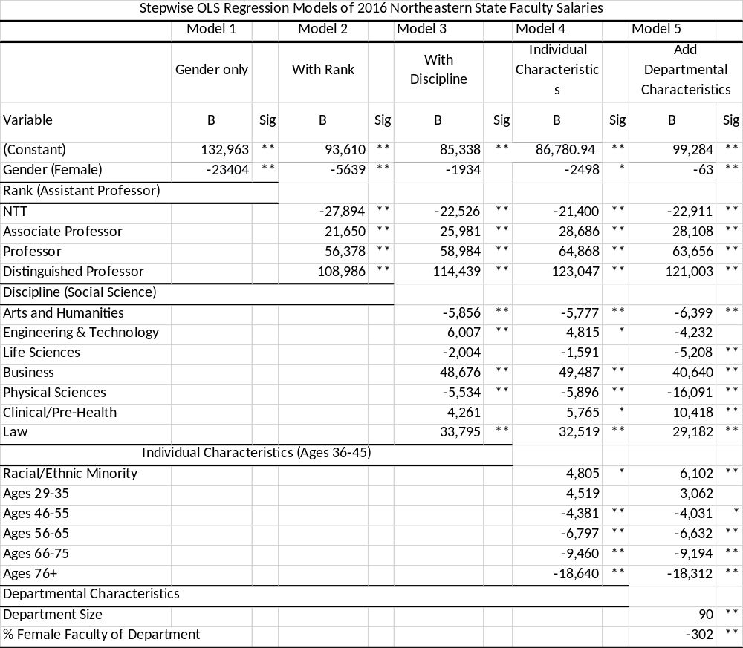

Slide 22
Departments are Segregated by Gender
Mean
Notes:
This graphic shows the percent of male and female faculty by what percent female their department is. On the lefthand side (gesture) you’ll see the percent of faculty of that gender ranging from 0 at the bottom to 45% at the top. And along the horizontal axis (gesture), you’ll see the percent of the department faculty who are female going from 0 up to 60 or higher.
The mean %female for all faculty is 40% with a standard deviation of 20, so the middle two categories are within 1 standard deviation, while the outer categories are within 2 standard deviations.
Like before, males are green and females are purple.

Slide 23
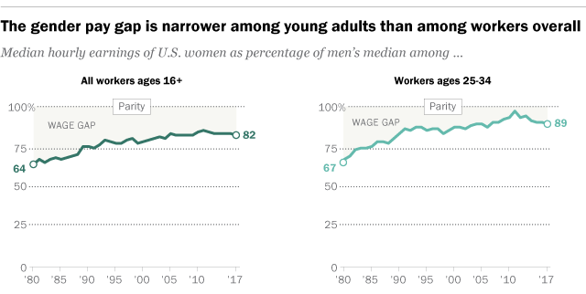
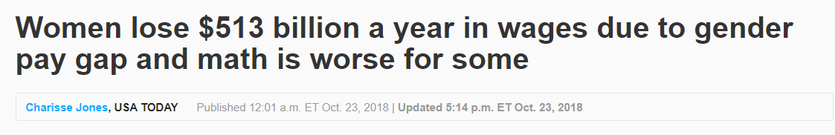
Is there a “Gender Pay Gap?”
Pew study found here: https://pewrsr.ch/2utSKlL
USA Today article found here: https://bit.ly/2PSojP7
Notes:
So the first questions we might ask is what constitutes a gender pay gap and is there one for faculty?
Generally research has looked at the “gender pay gap” in terms of how aklomuch less women make than men. (click) here we see Pew researchers have graphed the their data as the percent of men’s median earnings on the vertical axis (point) across years on the bottom here (point) (Point to lines). You can see from the chart women are still making less than 90% of men’s pay even in 2017. [click] The news has covered these types of studies to make that information more accessible to the broader public, as in this USA today article (point). [click] But is the same true for faculty?

Slide 24
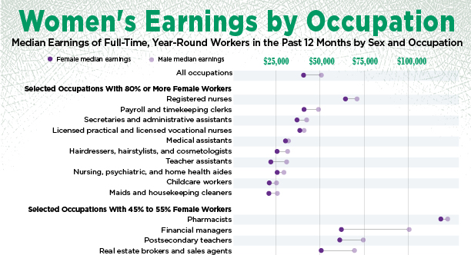
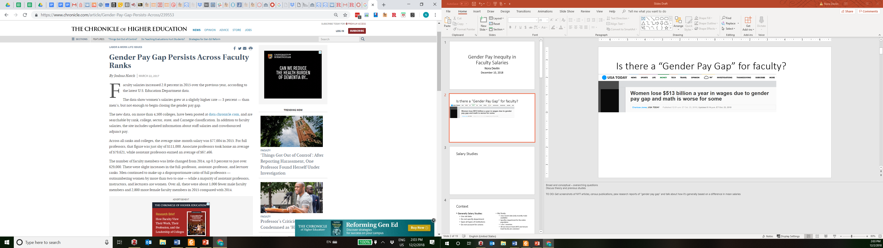
Is there a “Gender Pay Gap” for Faculty?
Women’s Earnings by Occupation published by U.S. Census Bureau here: https://bit.ly/2HP4W9z
Chronicle Article published here: https://bit.ly/2HjsGzb
Notes:
[click] As you can see [click], we have an example of the gap between what a man earns (light purple) and how much less a woman earns (dark purple), documented in 2016 by the Census bureau. Each line represents a profession(point), with salary plotted on the horizontal axis which is measured in increments of $25,000.
You’ll notice the second to last category in this view of the chart is “Post-secondary teachers” also known as college and university faculty. It looks like that line indicates a difference of close to $13,000, so we see as of 2016 female faculty were earning almost 20% less than male faculty. [click]
According to the Chronicle of Higher Education, [click] women still earned less than men [motion to slide] among faculty as recently as March 2017. So how have people studied this issue before?

